Slide 1

Flight Data Analysis Report

Slide 2

Introduction
This report presents an analysis of flight data aimed at extracting insightful trends and patterns. The dataset comprises various details about flights, including airlines, source and destination cities, flight duration, and pricing information. By examining this data, the analysis seeks to provide valuable insights for stakeholders such as airlines, travel agencies, and passengers. The report covers data preprocessing, exploratory data analysis (EDA), and data visualization to uncover significant trends and anomalies.

Slide 3
Project Goals
The primary goals of this project are:
Data Cleaning and Preprocessing: To clean and preprocess the flight data by handling missing values, removing unnecessary columns, and addressing outliers.
Exploratory Data Analysis (EDA): To conduct an in-depth analysis of the data to identify patterns, trends, and anomalies.
Data Visualization: To create visual representations of the data that highlight key insights and make the data easier to understand.
Insights Extraction: To draw actionable insights from the data that can inform decision-making for airlines, travel agencies, and passengers.

Slide 4
Methodology
Data Loading and Initial Exploration:
Libraries Used: The analysis utilized various Python libraries such as Pandas for data manipulation, NumPy for numerical operations, Matplotlib and Seaborn for data visualization, and warnings were filtered to improve readability.
Data Loading: The dataset was loaded using Pandas, with an initial shape of 301,206 rows and 13 columns.
Data Cleaning:
Column Removal: Unnecessary columns such as 'Unnamed: 0' were removed to streamline the dataset.
Handling Missing Values: The dataset had several columns with missing values. The 'date' column, which was almost entirely empty, was dropped. Other columns with missing values, such as 'price' and 'duration', were addressed appropriately.
Handling Outliers:
Outlier Identification: Box plots were used to identify outliers in key variables like 'price' and 'duration'.
Outlier Removal: The interquartile range (IQR) method was employed to remove outliers, ensuring the analysis focused on the most relevant data points.
Exploratory Data Analysis (EDA):
Descriptive Statistics: Summary statistics were calculated to understand the central tendency and dispersion of key variables.
Visualizations: Various plots and graphs were created to visualize the data and uncover patterns.

Slide 5
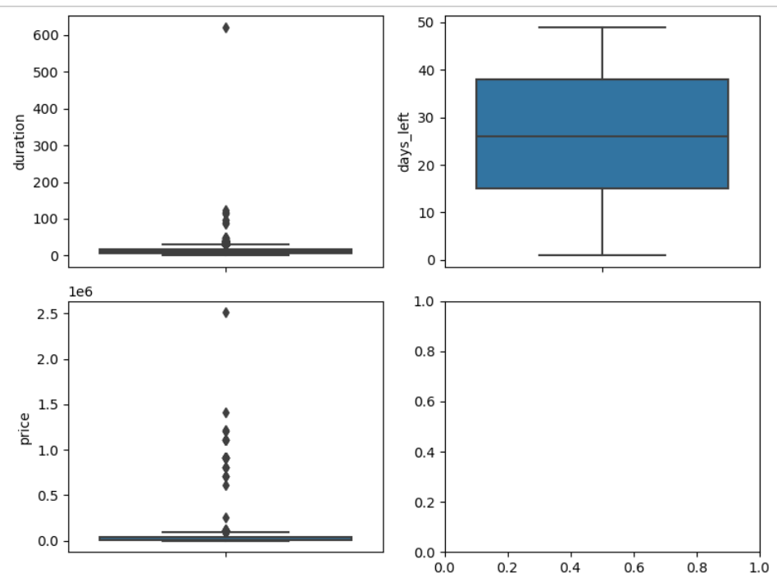
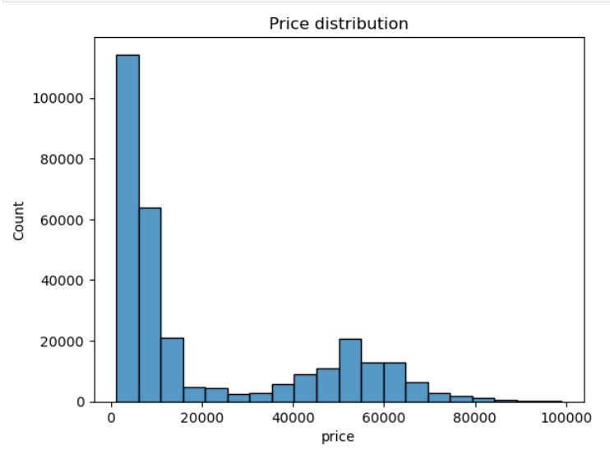
Data Visualization

Slide 6
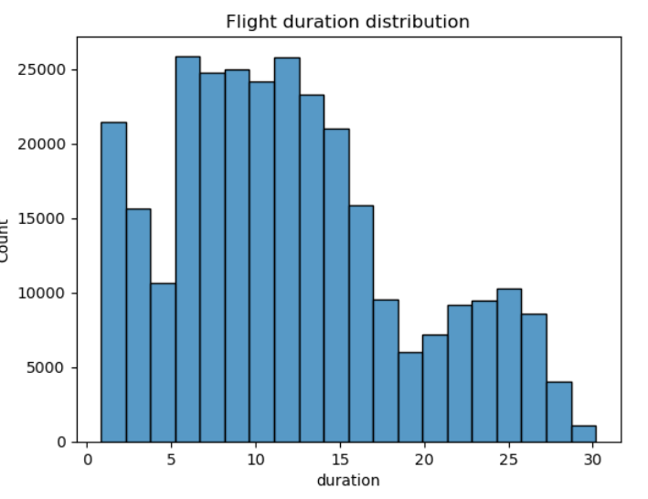
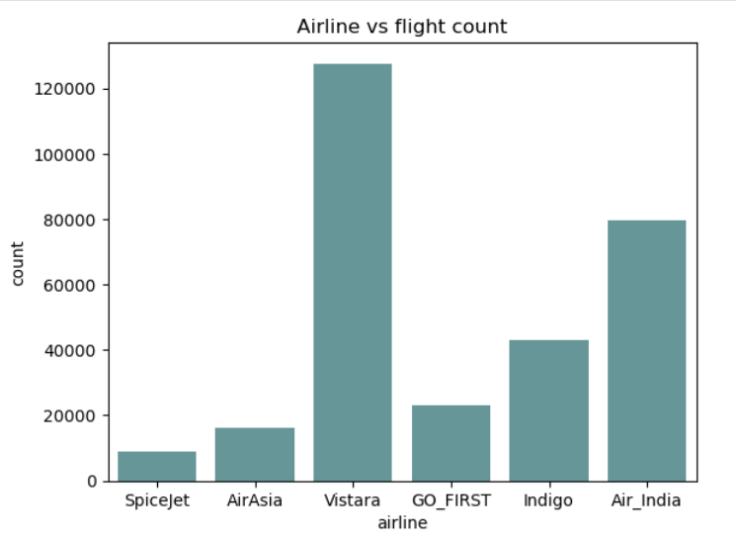

Slide 7
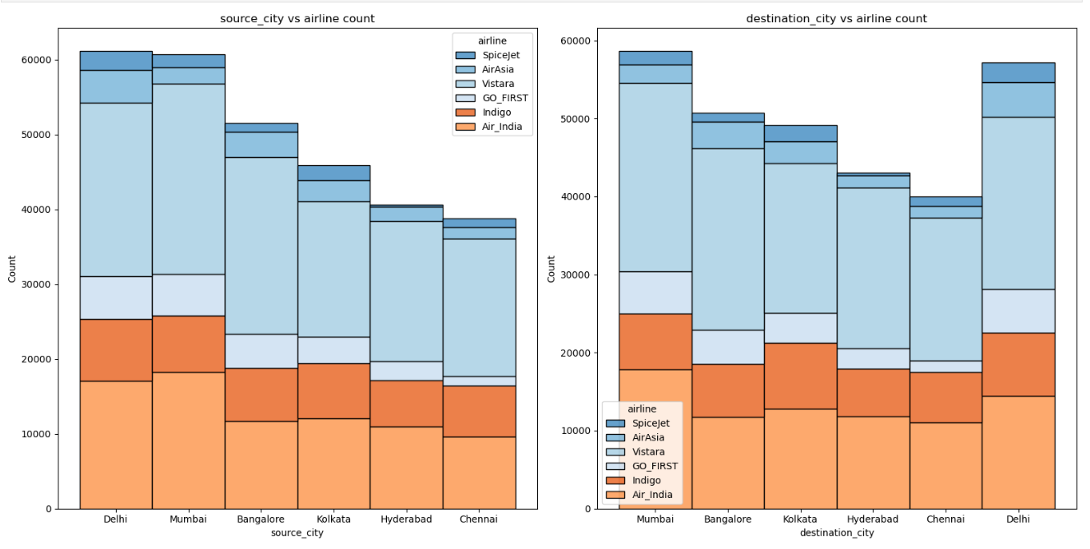
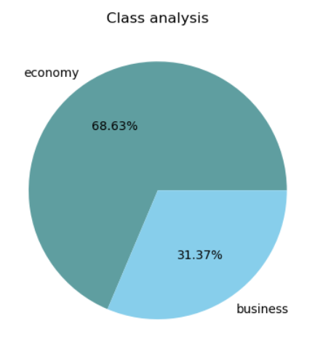

Slide 8
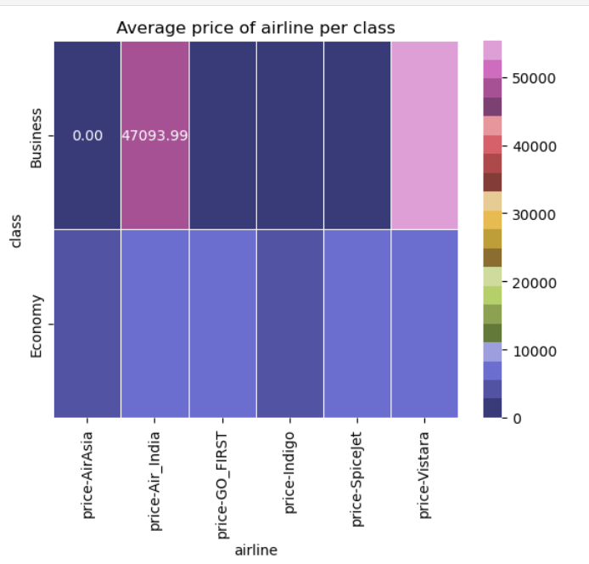
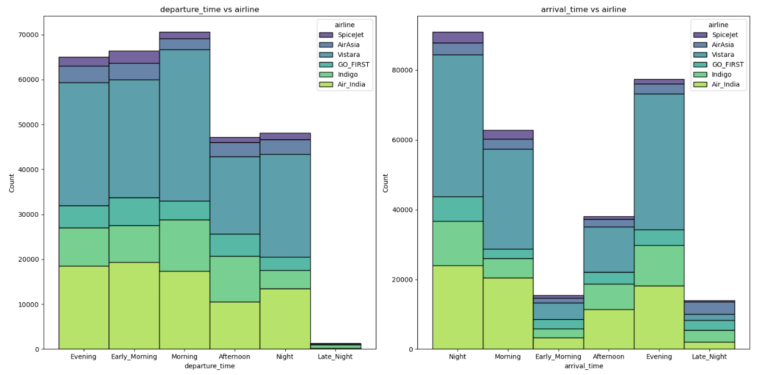

Slide 9
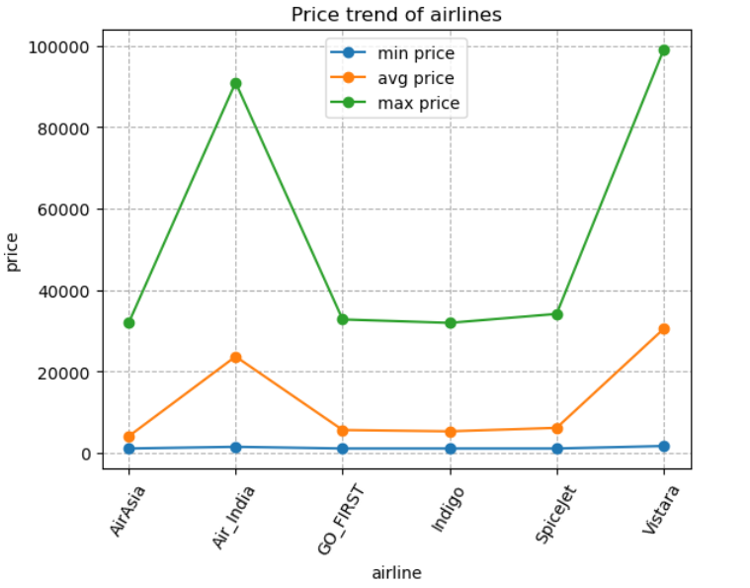
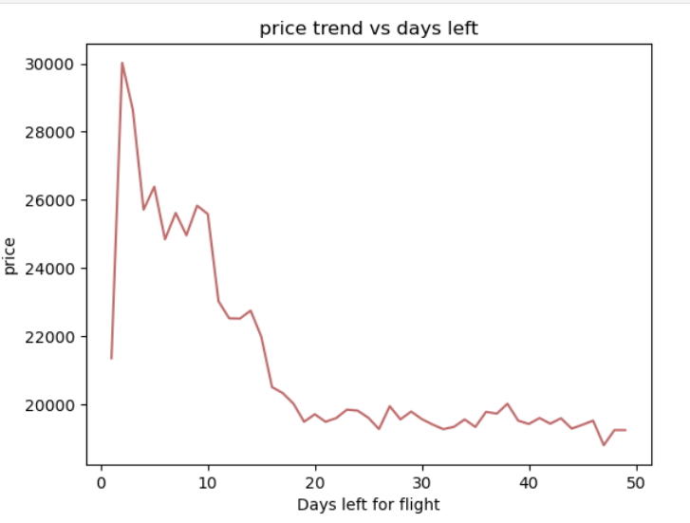

Slide 10
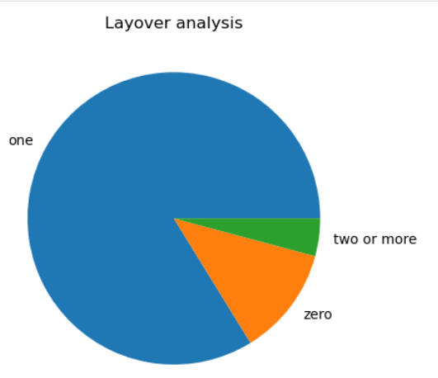

Slide 11
Conclusion
The analysis of the flight data revealed several important insights:
Data Cleaning: The data was effectively cleaned by removing unnecessary columns and handling missing values. The 'date' column, which had a high percentage of missing values, was dropped.
Outlier Removal: Outliers in the 'price' and 'duration' columns were identified and removed using the interquartile range (IQR) method. This ensured that the analysis focused on the most relevant data points.
Data Insights: Visualizations provided valuable insights into the distribution of key variables. The analysis revealed that flight prices and durations exhibited certain patterns, with some extreme values identified as outliers.
Booking Trends: The relationship between the number of days left before the flight and the price was explored, indicating that prices tend to be higher for flights booked closer to the departure date.
Overall, this project demonstrated the importance of data cleaning and visualization in uncovering meaningful insights from complex datasets. The findings can inform decision-making for airlines, travel agencies, and passengers, helping to optimize flight pricing and improve travel planning.

